Slide 1
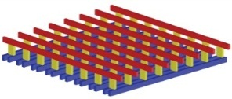
ECE191: Group D Pressure Sensor for Mobile
Mentor: Professor Truong Nguyen, Siarhei Vishniakou
Linh Dinh, Francis Tsui, Anish Bhayani, Joseph Lee
Sponsors:

Slide 2
Agenda
Gantt Chart
Week’s Accomplishments
Bluetooth Data Transfer
Demo of Works
Eclipse/ Android SDK
Github
Summary
Next Week’s Goals

Slide 3
Gantt Chart
 |  | Week | Week | Week | Week | Week | Week | Week | Week | Week | Week | Week
Stage | Progress | 1 | 2 | 3 | 4 | 5 | 6 | 7 | 8 | 9 | 10 | Final
Stage 0 | Project Overview
 | Research Hardware (Arduino/ Sensor/ Bluetooth)
 | Research Software (Arduino/ Matlab DSP toolbox)
Stage 1 | Flash from PC to Arduino
 | Simulate pressure sensor data by generate 8x8 random array
Stage 2 | Processing 2D/3D data using Matlab
 | Github (setup and documentation)
Stage 3 | Establish Wireless via Bluetooth
 | Develop Apps (IOS/Android) to display (2D/3D) real time data
Stage 4 | Interface via Bluetooth
 | Debugging/Optimizing/Finalizing
 | Documenting
Notes:
Talk about the updates: updating stage 3, changing priorities, see technology overview.

Slide 4
Week’s Accomplishments
Team1: Joseph, Anish
Set up Github
Research Java programming
Team2: Francis, Linh
Set up group/sponsor meeting
Testing Bluetooth data transfer
All members:
Set up Eclipse/ Android SDK
Run simple application “Hello World”

Slide 5
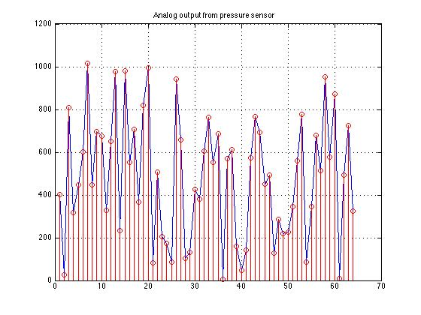
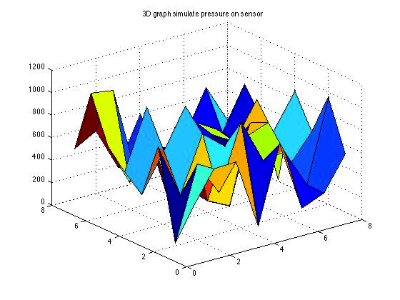
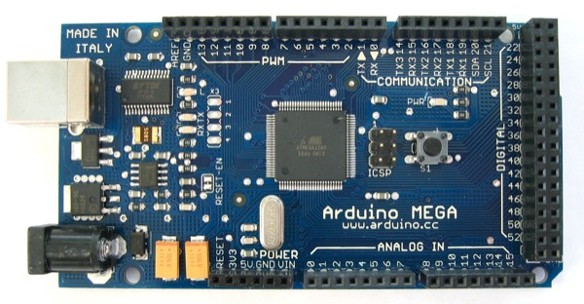
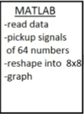
Summary of last week works
USB
Able to transfer data from Arduino to PC using a Serial Connection
Processed data by Matlab

Slide 6
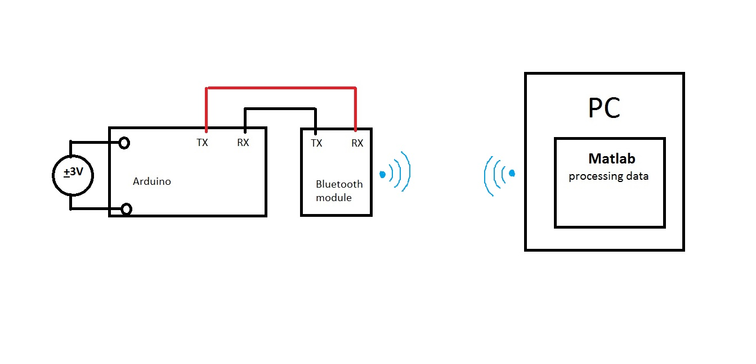
Bluetooth Data Transfer
Advanced to the next stage: replaced serial connection with Bluetooth connection
Successfully paired PC/Bluetooth module
Wirelessly transfer data/ process data by Matlab
Notes:
Need diagram

Slide 7
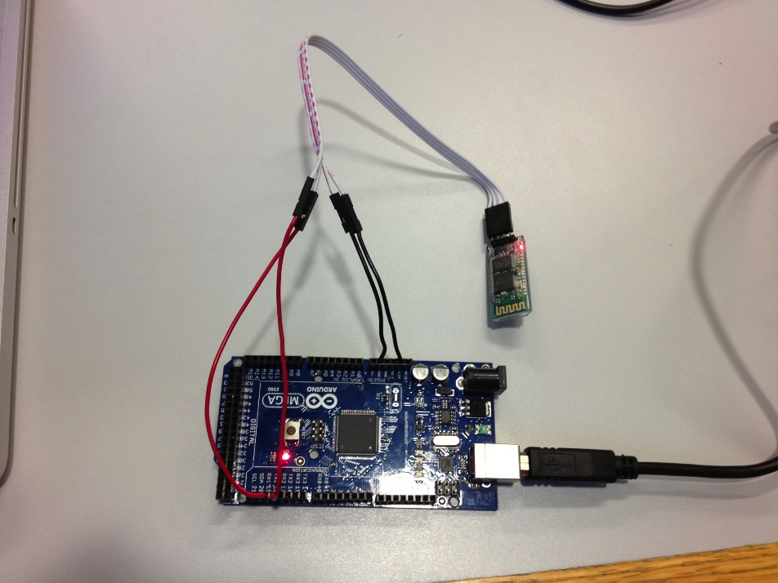
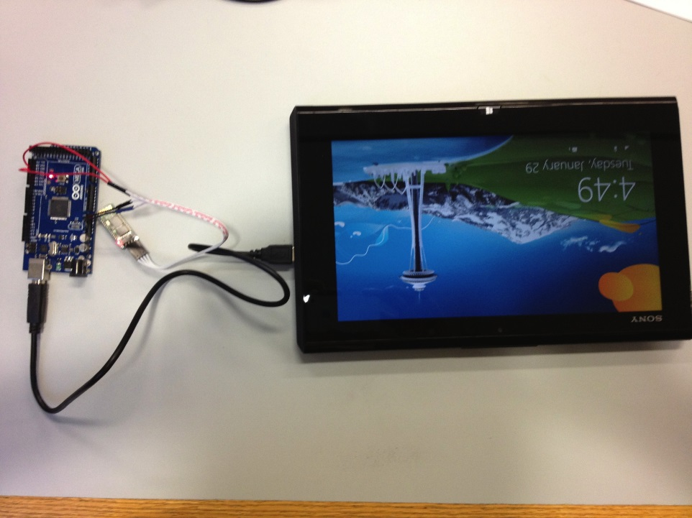
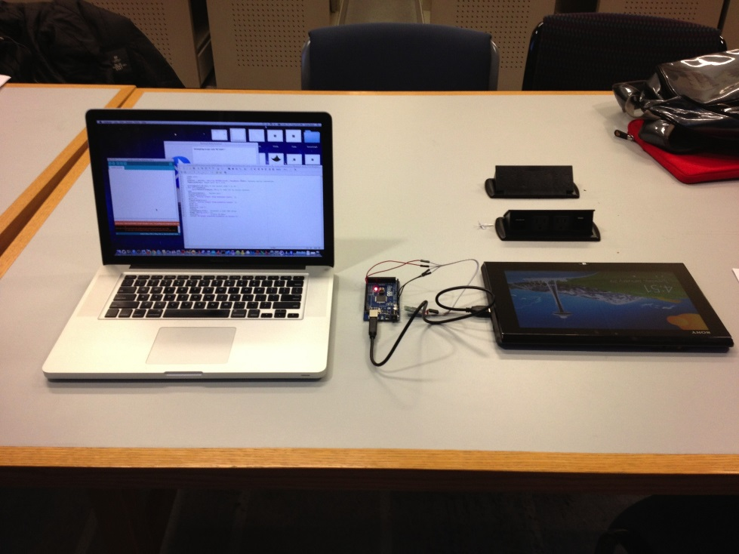
Demo
Bluetooth Module
Overall set up
Arduino
Powered Arduino by a Tablet
Notes:
In class demo of how wireless data processing work( show on laptop screen).

Slide 8
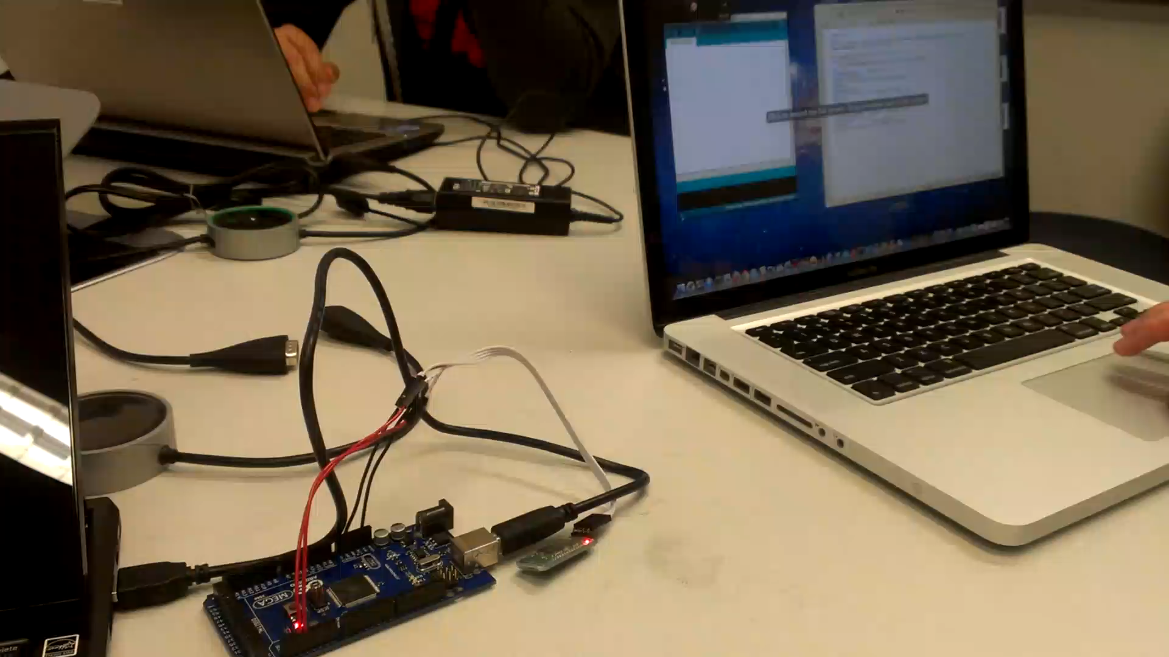

Slide 9
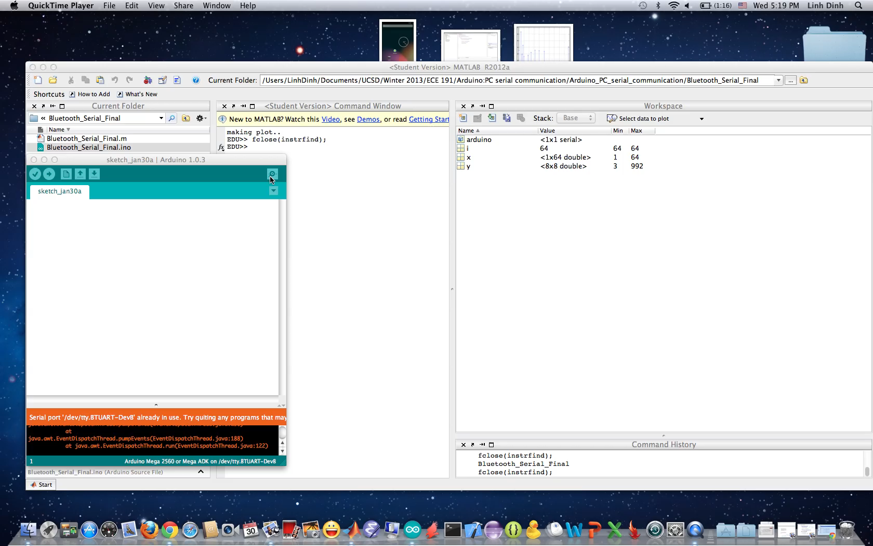
Demo

Slide 10
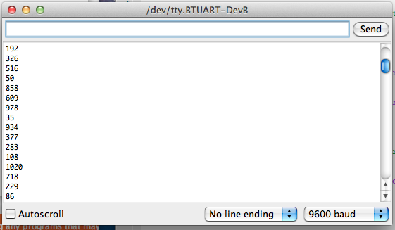
Result
Voltage Step
Sensor position (x)
Sensor position (y)
Arduino Serial Monitor
3d plot generated by Matlab

Slide 11
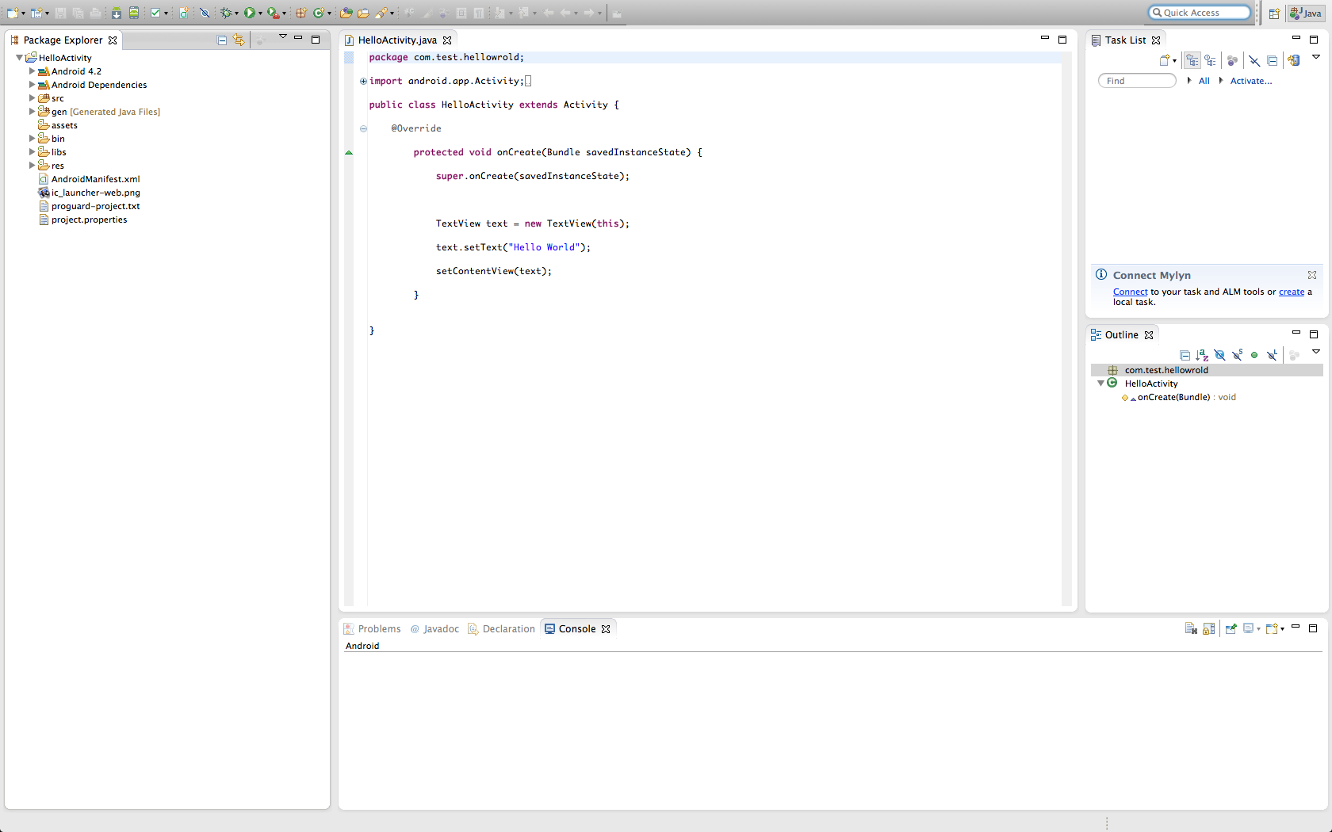
Eclipse/ Android SDK
Start developing mobile application to process data
Successfully installed Eclipse/ Android SDK
What is Eclipse?
A software development environment, is written mostly in Java
What is Android SDK?
Developer tools to build, test, and debug apps for Android

Slide 12
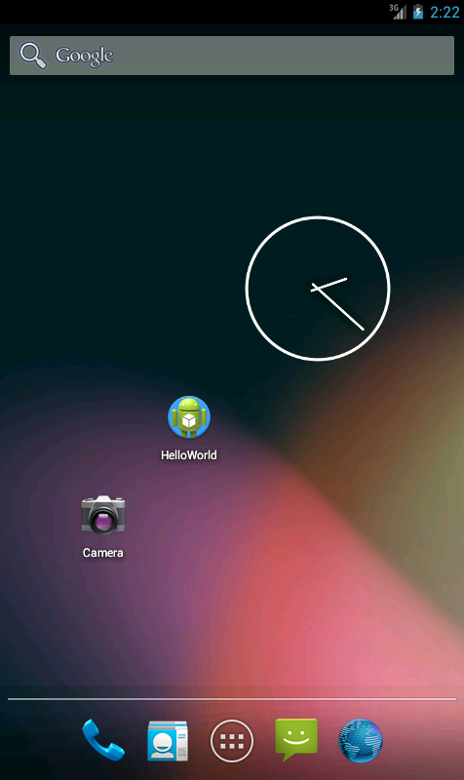
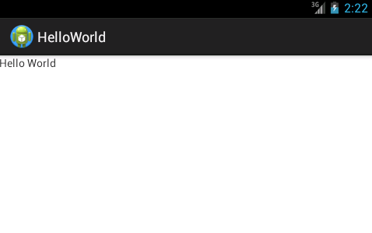
Our 1st Android application
Notes:
Need screenshot

Slide 13
Github

Slide 14
Summary

Slide 15
Next Week’s Goals
Bluetooth
Adjust higher Baud rate for Bluetooth
Developing connection to Android phone
Sensor
Display reading from a single sensor on mobile device
Notes:
See Francis: please add branch Bluetooth connection to phone.

Slide 16
Thank you
Q&A session

